Slide 1


Full Stack Development

Slide 2


Overview
Introduction
What is full Stack?
Front End Development
Front End Frameworks and libraries
Back End Development
Back End Frameworks and libraries
Database Management Systems

Slide 3

Introduction

Slide 4
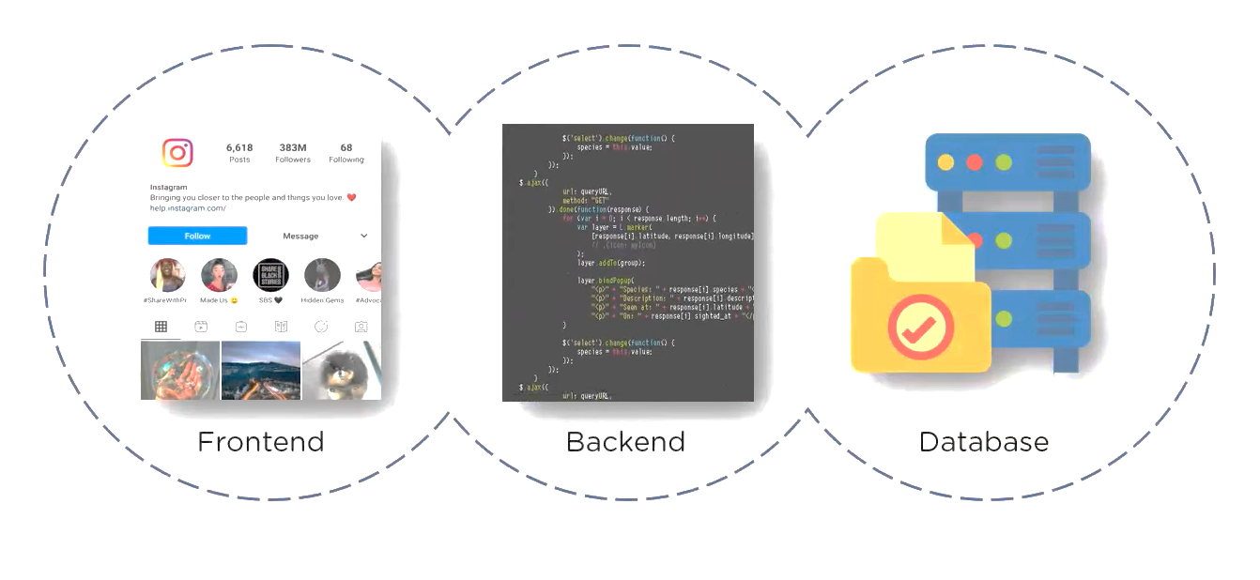

FULL STACK

Slide 5

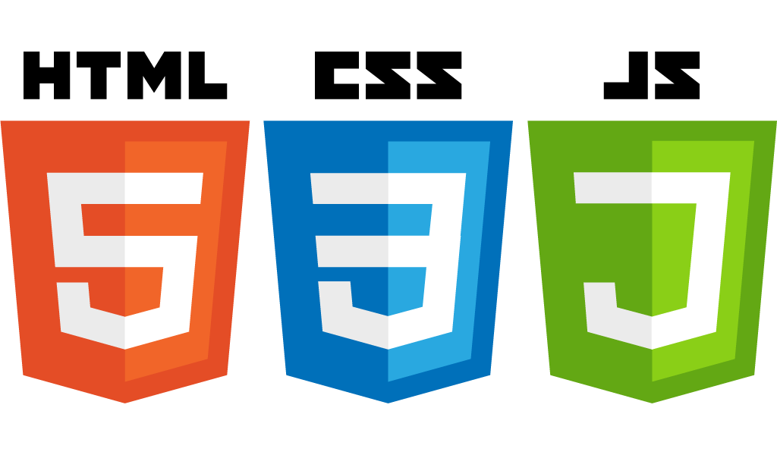
Front End Development
Front end refers to the part of a website or web application that users interact with directly
Front End Languages:-
HTML (HyperText Markup Language) – Defines the structure of web pages.
CSS (Cascading Style Sheets) – Styles the web pages (colors, layouts, fonts, animations)
JavaScript – Adds interactivity and dynamic behavior.

Slide 6

All of these Applications that we see facilitates
Navigation
Utility

Slide 7
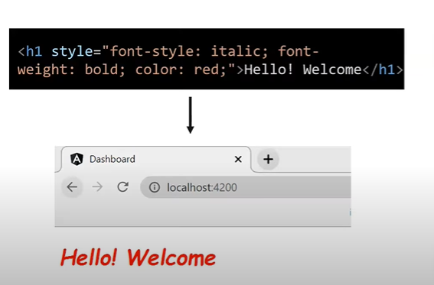
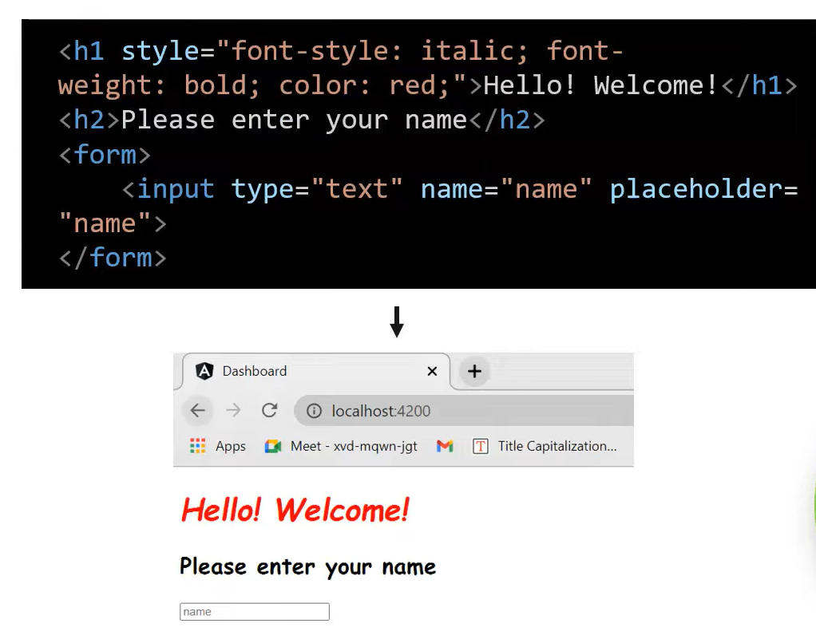
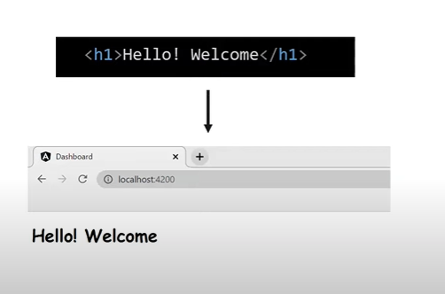
Front End
HTML
CSS
Java Script

Slide 8

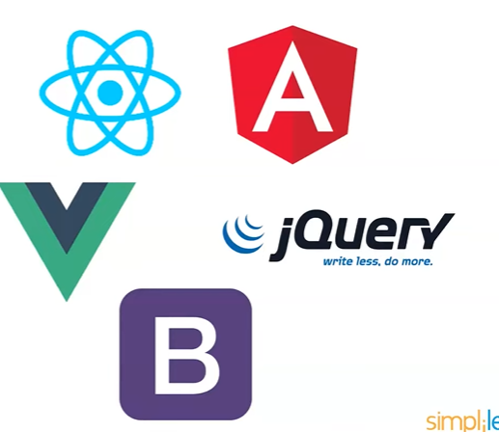
Front End Frameworks
Front-end frameworks are used to streamline the development of web applications by providing pre-built components, structured architecture, and best practices.
Vue
React
jQuery
Bootstrap
Angular

Slide 9

01
Back End refers to the server-side development of the applications
02
Queries the Database and retrieves from DB and presents to user
Back End Development
03
Ensures Data Consistency
0

Slide 10




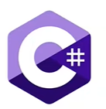



Backend Languages and Frameworks

Slide 11
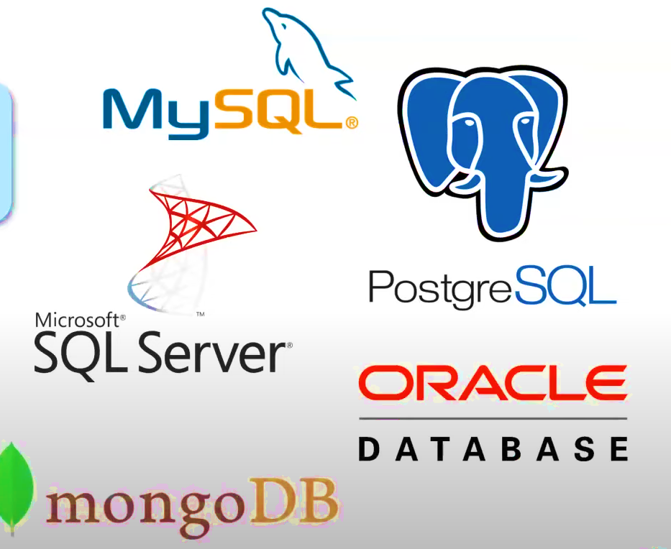
Database Management System
01
Addition of Data
02
Retrieval of Data
03
Manipulation/Deletion of Data
0

Slide 12
THANK YOU!

